Slide 1
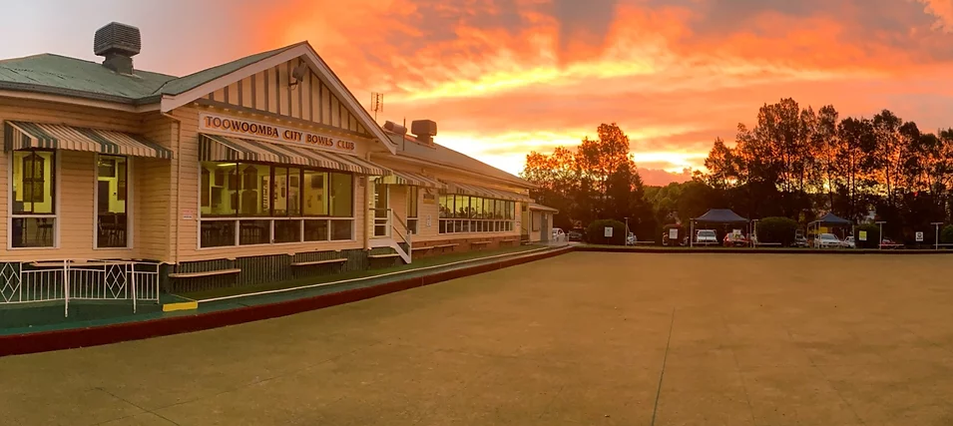



MEALS - PLATED
FISH – CRUMBED OR BATTERED WITH CHIPS & SALAD
CHICKEN SCHNITZEL WITH CHIPS & SALAD
BEEF SCHNITZEL WITH CHIPS & SALAD
COLD MEAT – HAM & SALAD
B.B.Q.
B.B.Q. PLATED SAUSAGE PATTIE WITH ROLL, CHIPS & SALAD
HAMBURGER – BEEF PATTIE ON A ROLL WITH SALAD & CHIPS
STEAK BURGER - ON A ROLL WITH SALAD & CHIPS
SAUSAGE SIZZLE ON BREAD
B.B.Q. HIRE
PLATTERS
COLD or HOT PLATTER
HOT CHIPS
MORNING AND AFTERNOON TEAS for meetings (Incl tea, coffee, cakes & biscuits)
WAKES (Incl tea, coffee, sandwiches & cake)
** VEGETARIAN AND GLUTEN FREE OPTIONS ARE AVAILABLE UPON REQUEST
FACILITI
VENUE HIRE INCLUDING AUDIO VISUAL EQUIPMENT
BAREFOOT BOWLS (PER PERSON)
FULL BAR FACILITIES AVAILABLE AT VERY COMPETITIVE PRICES children 10 or under; no charge for bowls or food
TEA AND COFFEE
FULLY DISABLED ACCESSIBLE
ALL PRICES ARE GST INCLUSIVE
COME TO THE ‘FRIENDLIEST LITTLE CLUB IN TOWN’ FOR YOUR NEXT PARTY, MEETING OR CONFERENCE
BOWLS & FUNCTION PACKAGES ARE ALSO AVAILABLE – PLEASE ASK OUR FUNCTIONS MANAGER FOR DETAILS.
CONTACT - PHONE: 0427 177 385 EMAIL: citybowls@bigpond.com;
TOOWOOMBA CITY BOWLS CLUB
FUNCTION
MENU

